Slide 1
Content Objective: Students will be able to explain why biomolecules are important to all living things and describe the structure and function of biomolecules.
Language Objective:
Students will discuss the 4 types of biomolecules with a partner and then write new vocabulary based on visual representations of the structures, notes will be recorded in their interactive notebooks.
Key Vocabulary: Biomolecules, Carbohydrates, Lipids, Proteins, Nucleic Acids, monomer, polymer, bond, function

Slide 2
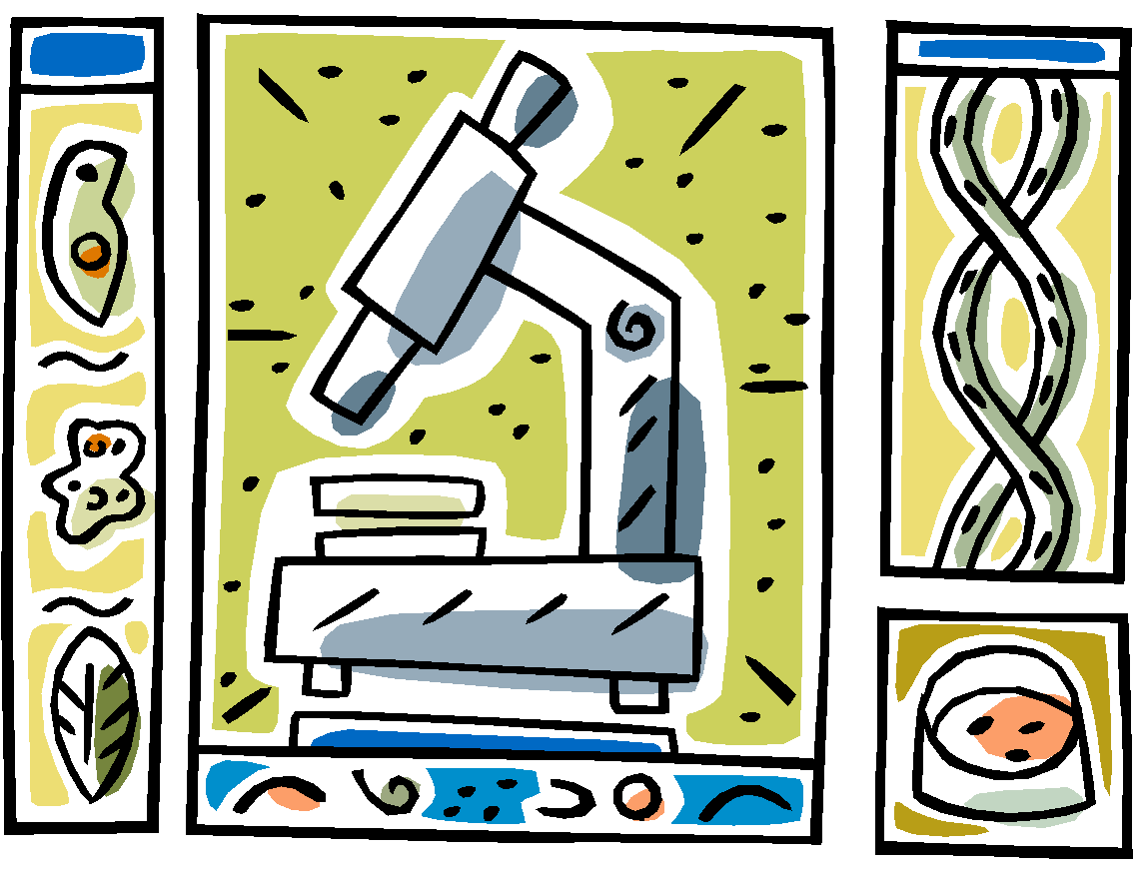
BIOMOLECULES
Four groups of organic compounds found in living things are carbohydrates, lipids, nucleic acids and proteins.
aka: Macromolecules
“macro” = large

Slide 3
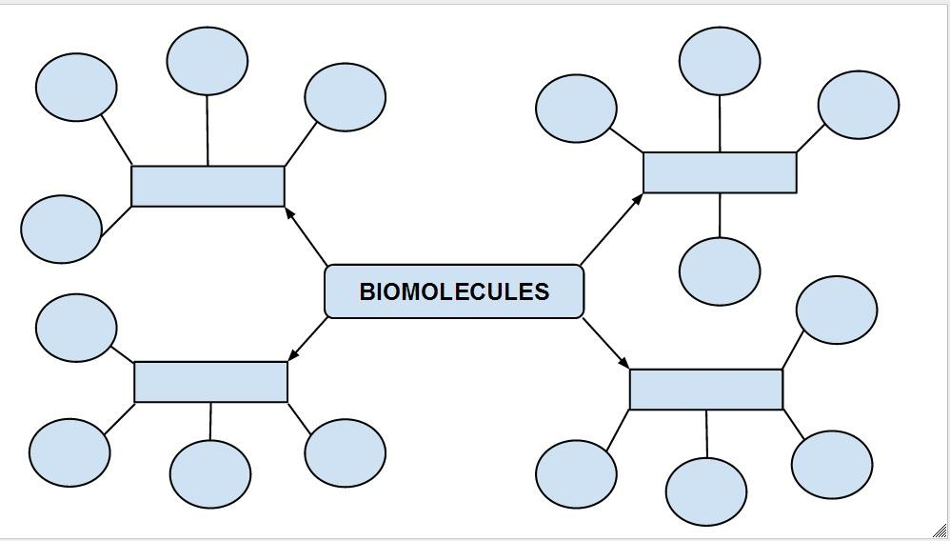
Concept Map
fill in the blanks!

Slide 4
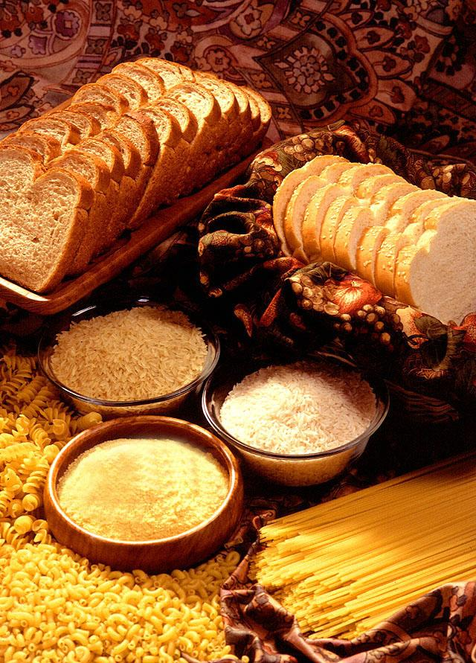
CARBOHYDRATES
Function: Living things use carbohydrates as their main source of energy.
Plants and some animals use carbohydrates for structural purposes.

Slide 5
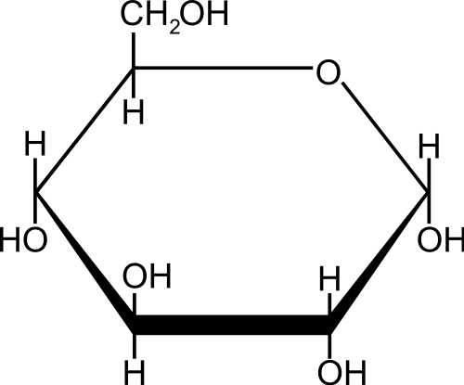
CARBOHYDRATES
Monomer: carbohydrates are made of monosaccharides
“mono” = one
“saccharide” = sugar
GLUCOSE
Structure:
Elements
C H O

Slide 6
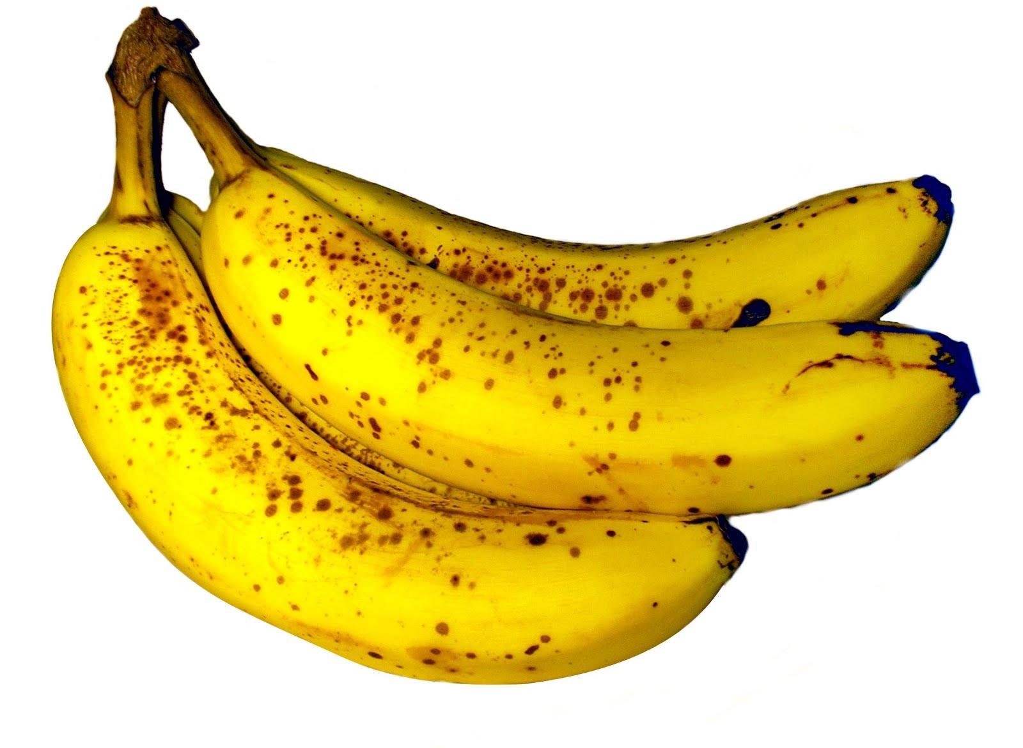
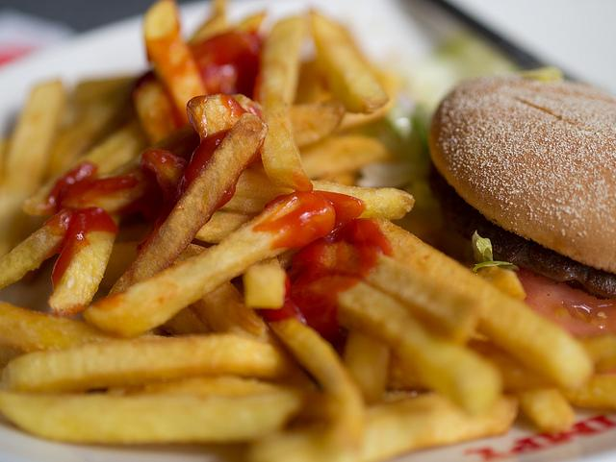
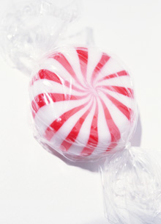
Examples of Carbohydrates
Think about your food ad….

Slide 7
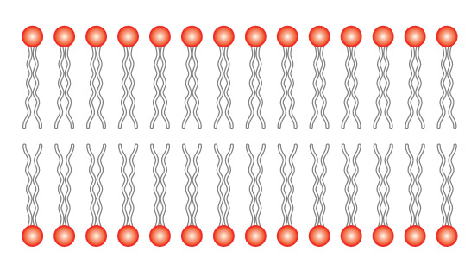
LIPIDS (fats)
Functions:
Lipids can be used to store energy for later use
Phospholipids are important parts of biological membranes

Slide 8
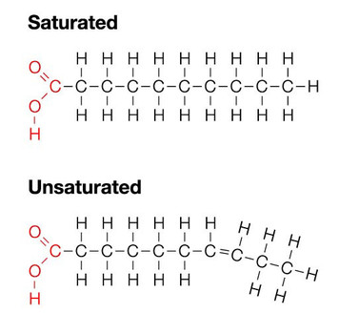
Lipids
Monomer: lipids are made of a glycerol and fatty acid chains
Structure:
Elements
C H O
Explain how the number of bonds is related to the amount of energy stored.

Slide 9
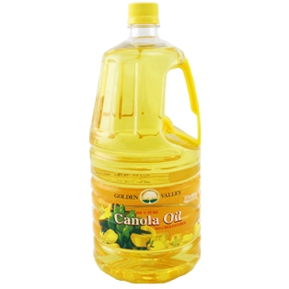
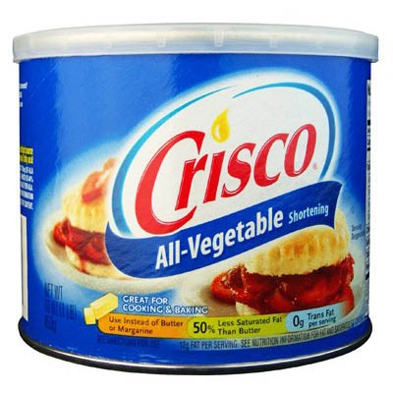
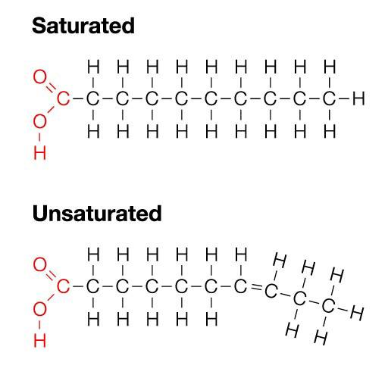
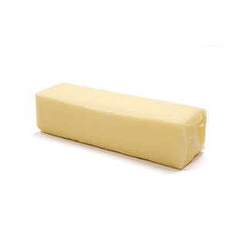
Examples of Lipids
Think about your food ad….

Slide 10
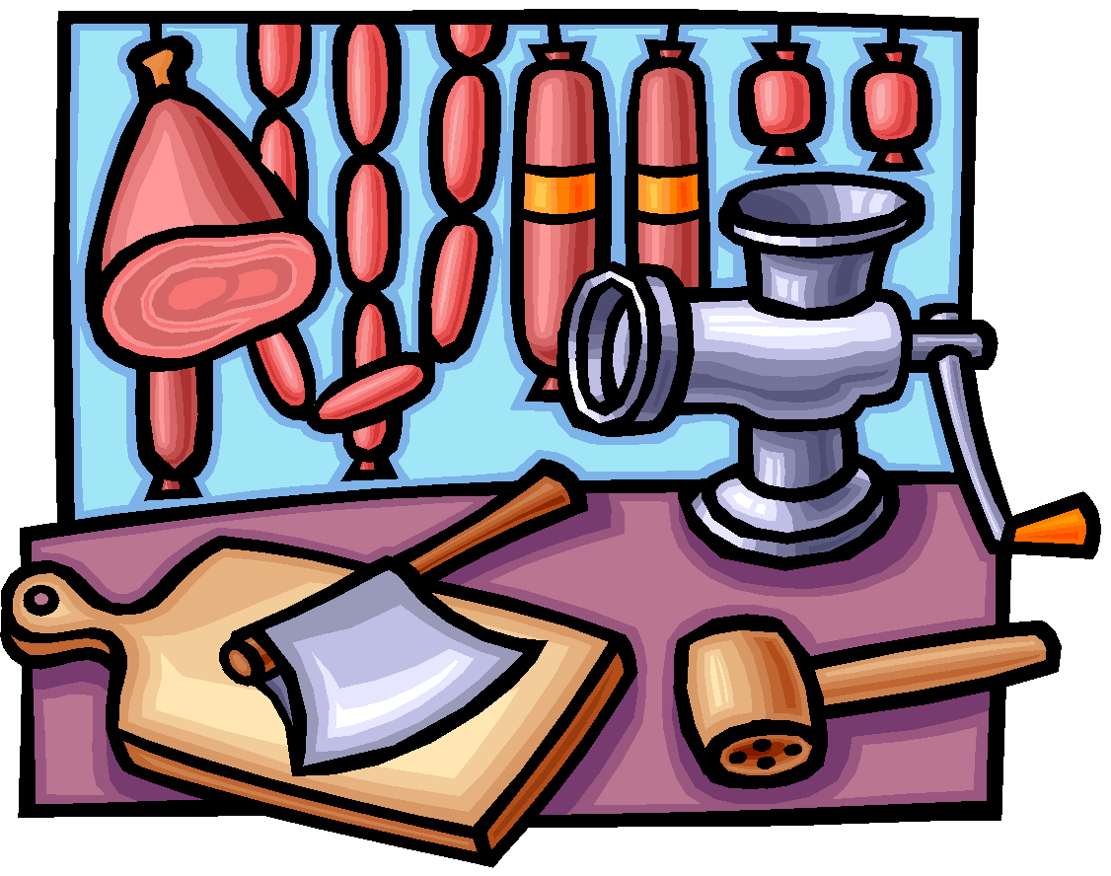
PROTEINS
Functions:
Some proteins control the rate of reactions and regulate cell processes.
Some are used to form muscles.
Others transport substances into or out of cells

Slide 11
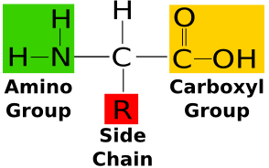
Proteins
Monomer: proteins are made of a chain of amino acids
Structure:
Elements
C H O N

Slide 12
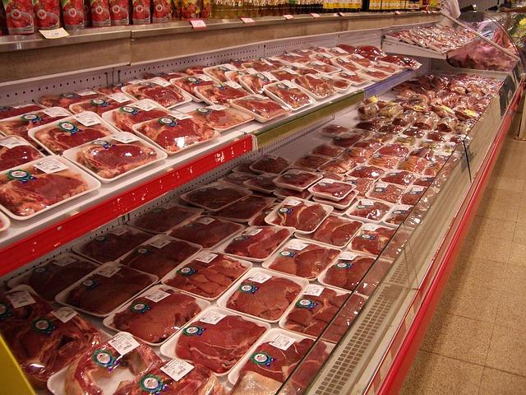
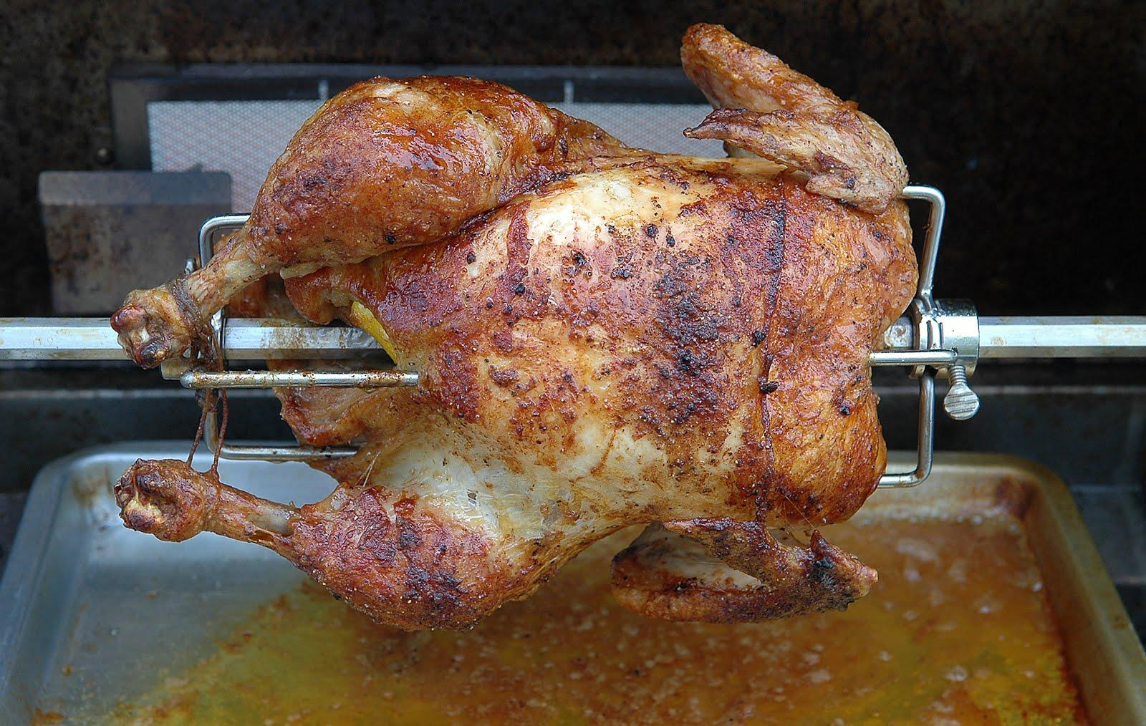
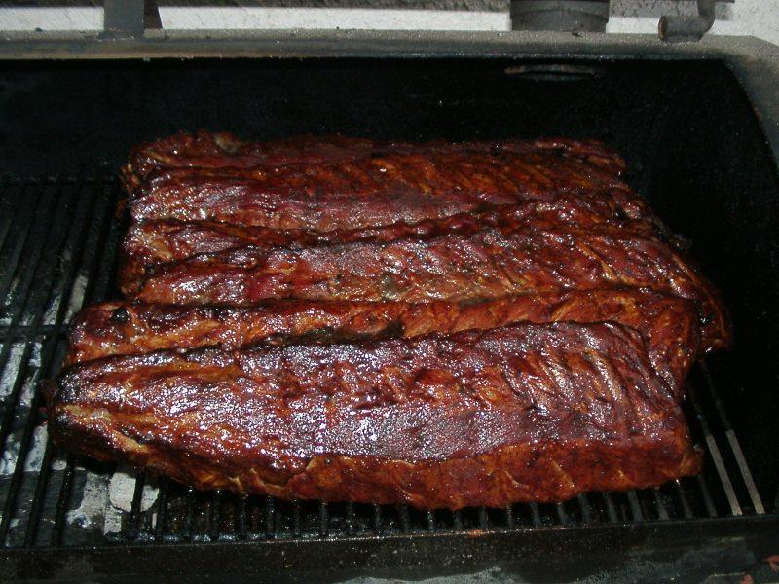
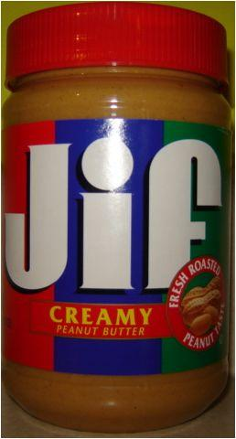
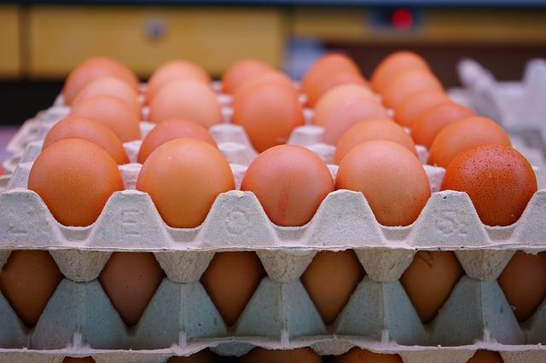
Examples of Proteins
Think about your food ad….

Slide 13
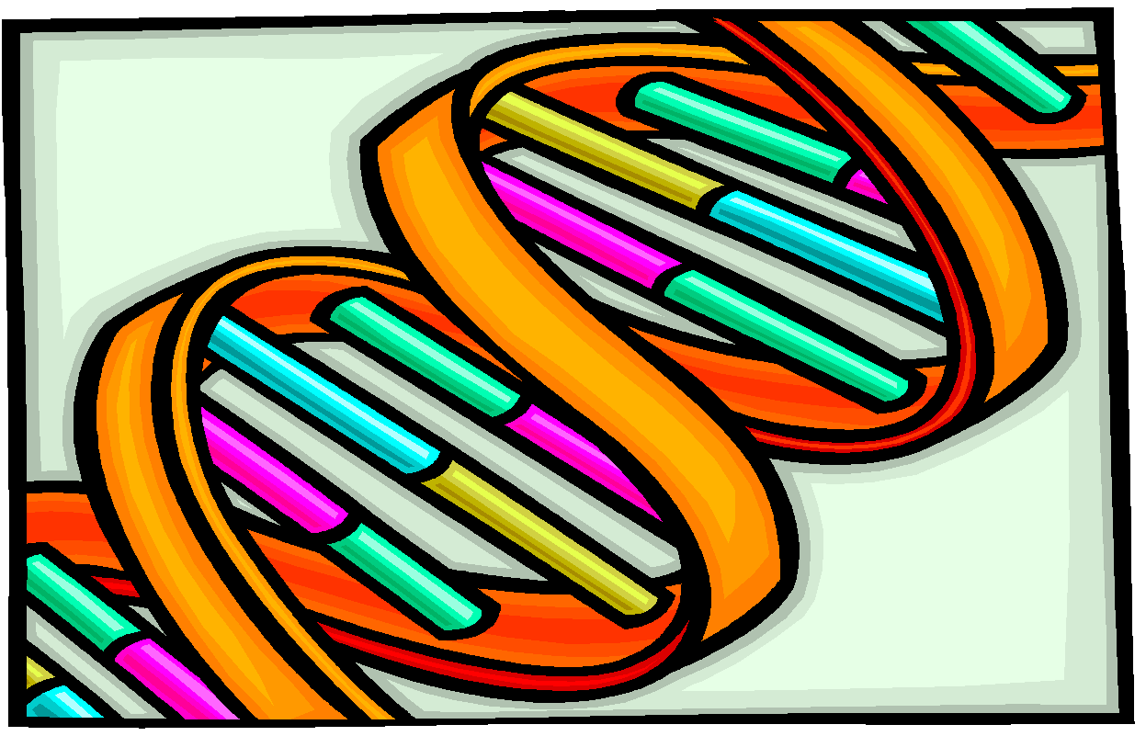
NUCLEIC ACIDS
Function: Nucleic acids store and transmit hereditary or genetic information.
Examples: two kinds of nucleic acids:
RNA – ribonucleic acid
DNA – deoxyribonucleic acid

Slide 14
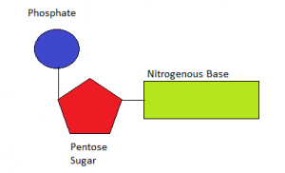
Nucleic Acids
Monomer: nucleic acids are made of a chain of nucleotides
Structure:
Elements
C H O N P

Slide 15
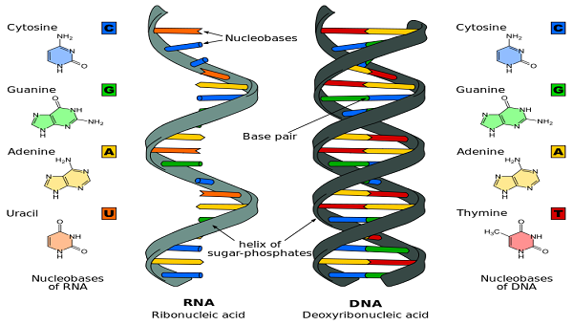
Examples of Nucleic Acids
already in your body!

Slide 16
Based on what we have just reviewed- How does the structure relate to function in biomolecules?

Slide 17
Can you…...
1. Identify the monomers of each biomolecule.
2. Can you explain the function of each biomolecule?
3. Explain why biomolecules are considered polymers.

Slide 18
Next class = Biomolecule Lab
Pre-lab: Copy data table

