Slide 1
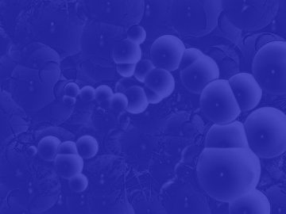
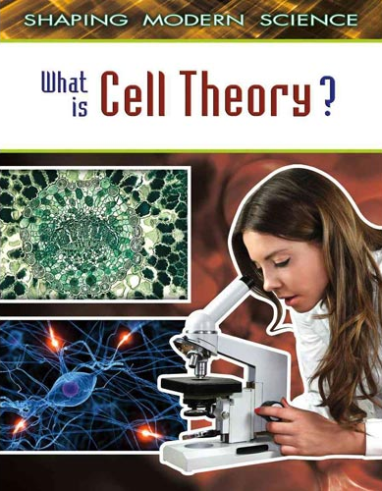
Cell Theory

Slide 2
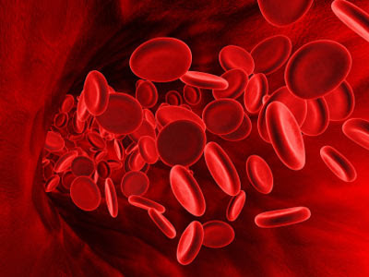
A cell is the basic unit of life.
Blood cells

Slide 3
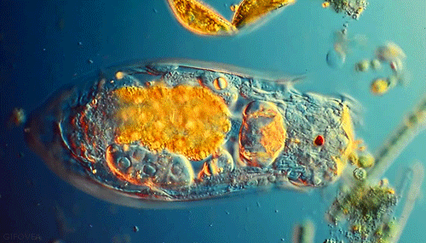
The Cell Theory states :
1.All organisms are made up of
one or more cells.
Protist: unicellular

Slide 4
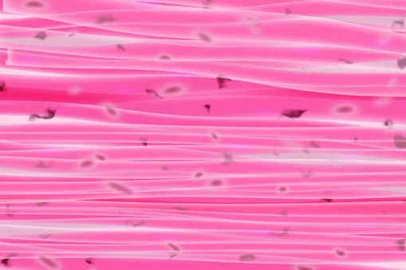
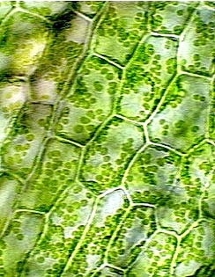
Multicellular

Slide 5
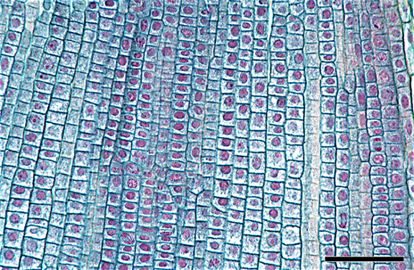
2. Cells are the basic unit of
structure and organization
of organisms.

Slide 6
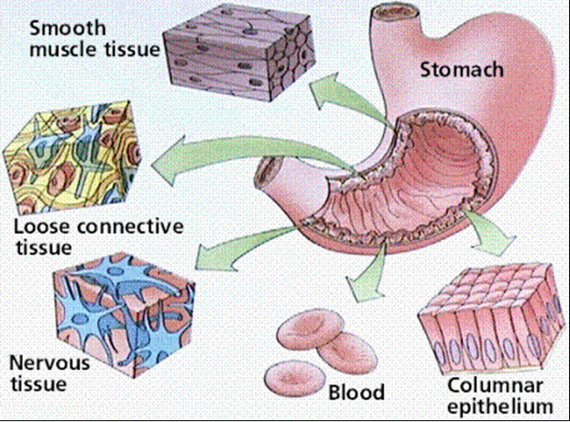

Slide 7
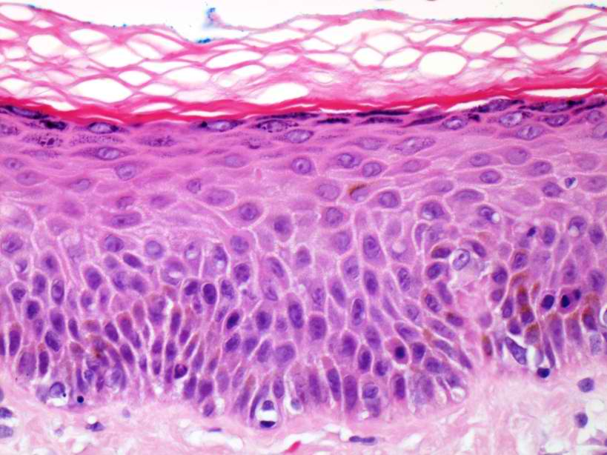
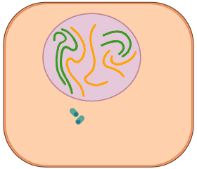
3. New cells come from
preexisting cells.

Slide 8
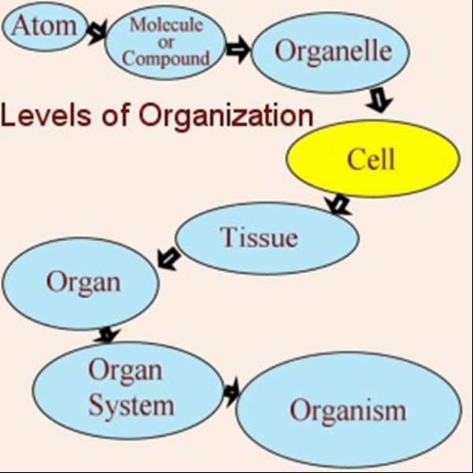

Slide 9
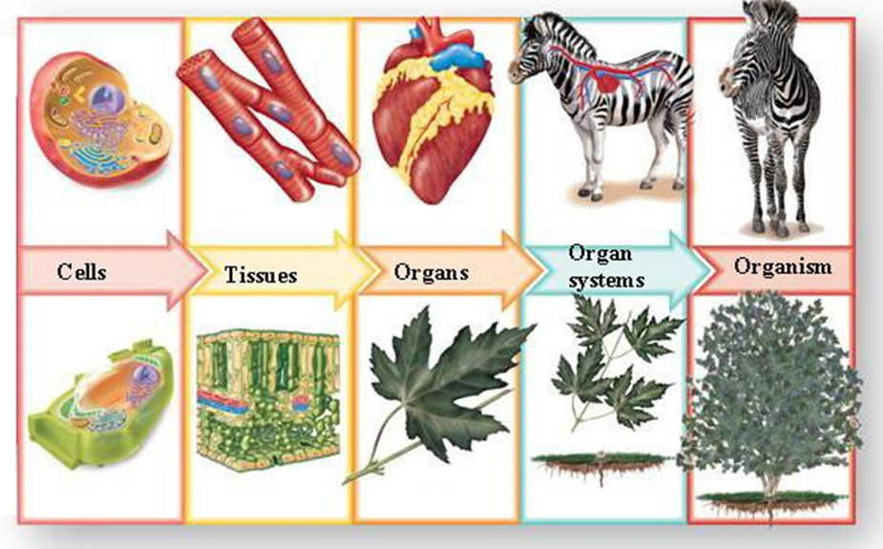
Levels of organization
Cells → tissue → organ → organ system → organism

Slide 10
Levels of organization

Slide 11
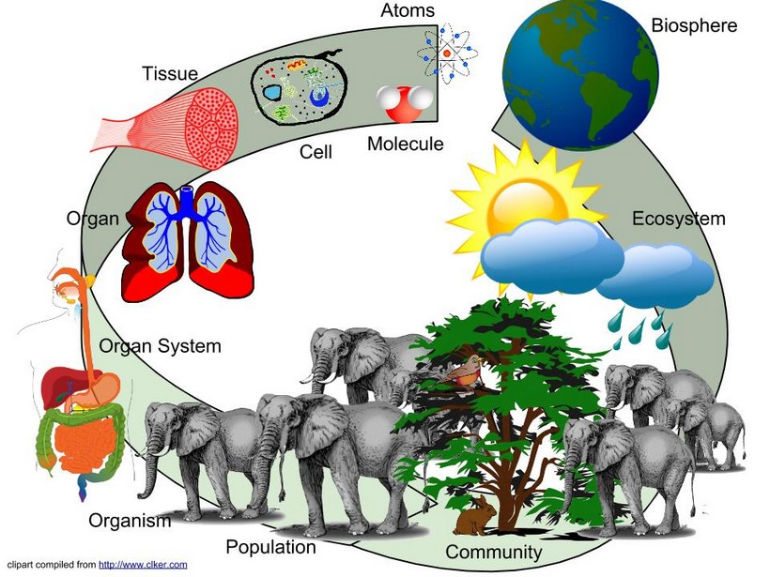
Levels of organization

