Slide 1
Endosymbiotic Theory

Slide 2
Symbiosis occurs when two different species benefit from living and working together.

Slide 3
When one organism actually lives inside the other it's called endosymbiosis.

Slide 4
1. Most membrane-bound organelles in the eukaryotes probably originated from the folds of cell membrane.

Slide 5
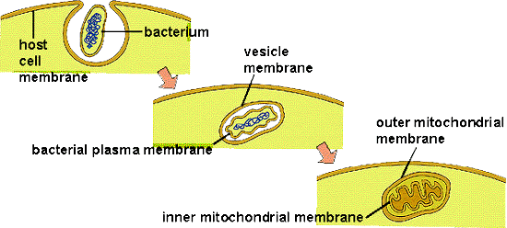

Slide 6
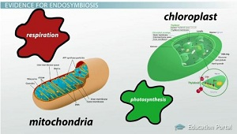

Slide 7
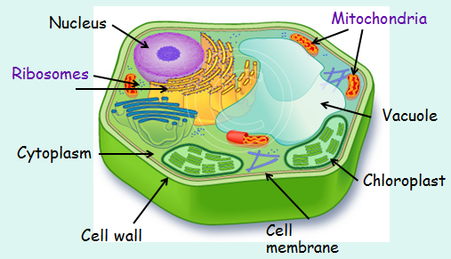

Slide 8
2.Mitochondria and chloroplasts represent formerly free-living bacteria that were taken inside another cell.

Slide 9
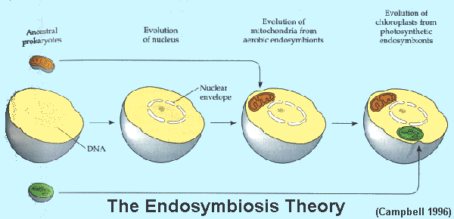

Slide 10
