Slide 1
Characteristics of Life
vocabulary: biotic and abiotic

Slide 2
Fact or Fib!
Take a scrap piece of paper and tear it in half
write on 1 “fact”
write on the other “fib”
FACT
FIB

Slide 3
RULES:
pair up!
a slide will be shown-do NOT say anything!
take 10 seconds to think “fact or fib”
when the teacher says go slap the card down you believe is the answer
discuss with your partner for 30 seconds
share ideas as a class

Slide 4
Living or Nonliving
the goal of this fact or fib game is to create a list of characteristics for things that are living!

Slide 5
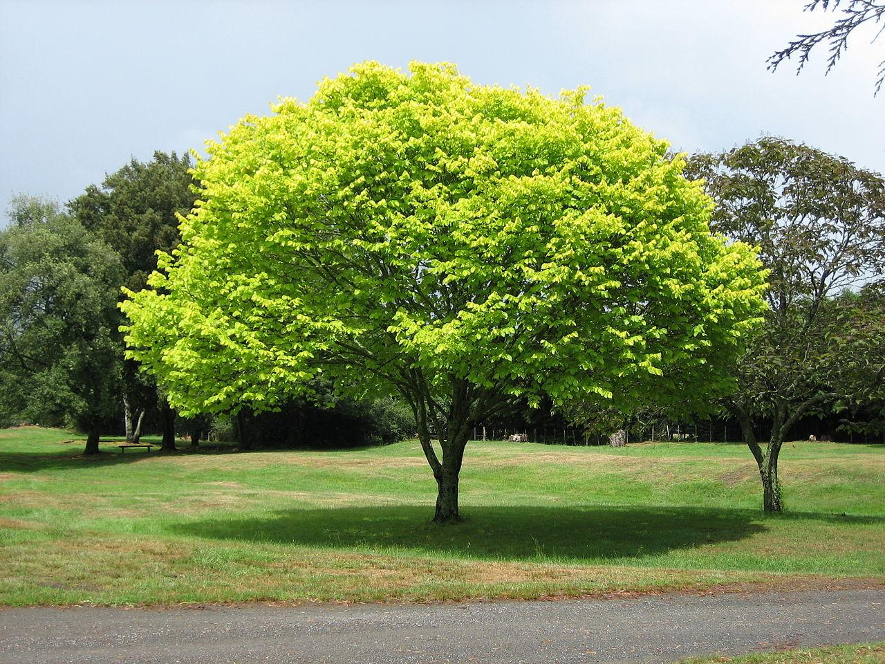
This is……….LIVING. (fact or Fib?)
Don’t say anything!
Don’t slap down till teacher says go!

Slide 6
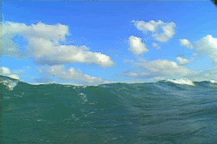
This is……….LIVING. (fact or Fib?)

Slide 7
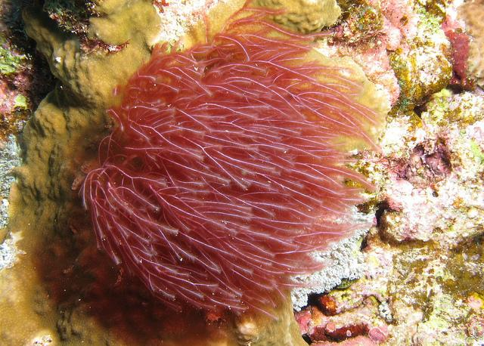
This is…NOT LIVING. (fact or Fib?)

Slide 8
This is……….LIVING. (fact or Fib?)

Slide 9
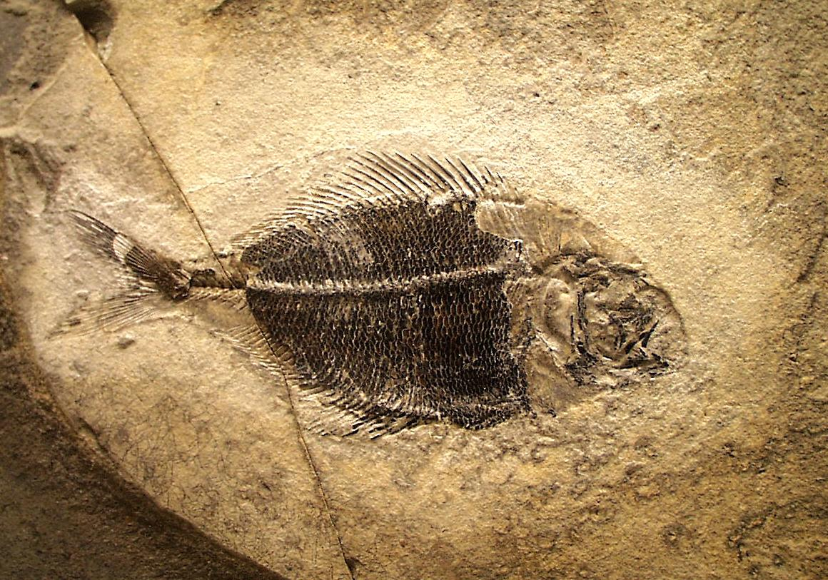
This is…NOT LIVING. (fact or Fib?)

Slide 10
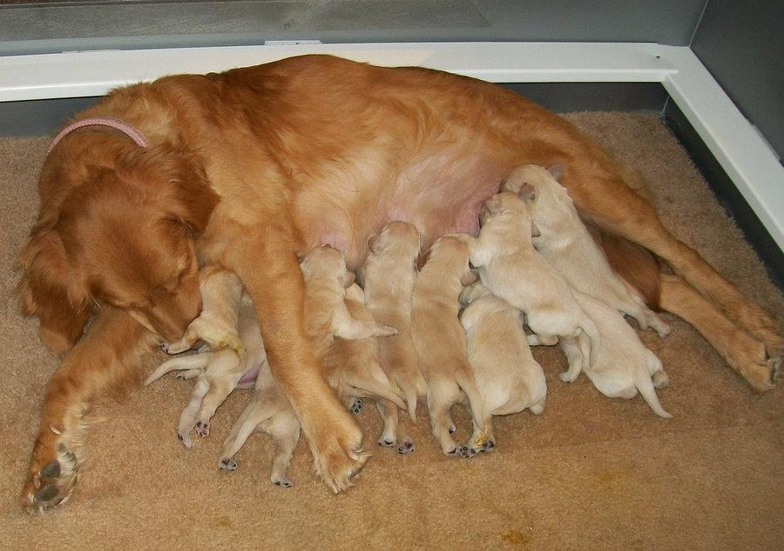
This is…NOT LIVING. (fact or Fib?)

Slide 11
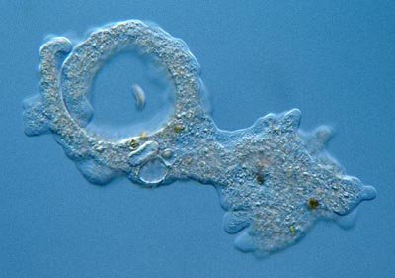
This is……….LIVING. (fact or Fib?)

Slide 12
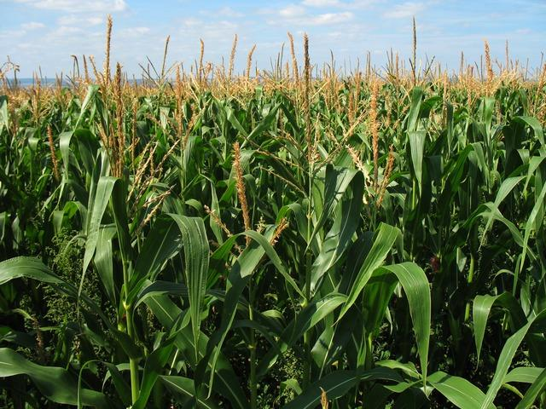
This is…NOT LIVING. (fact or Fib?)

Slide 13
Create a list of characteristics of life
# in your notebooks 1-7

Slide 14
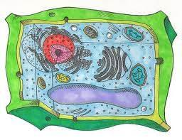
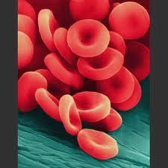
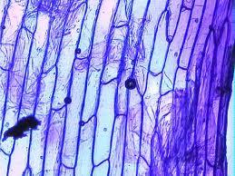
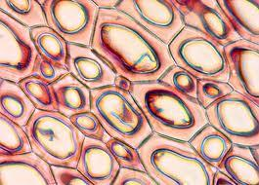
1. are made up of (one or more)units called cells.

Slide 15
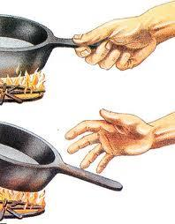
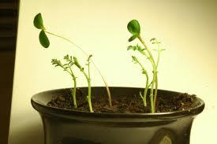
2. respond to their environment.

Slide 16
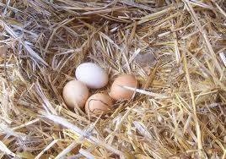
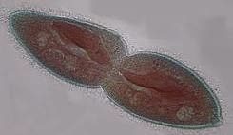
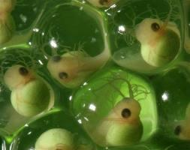
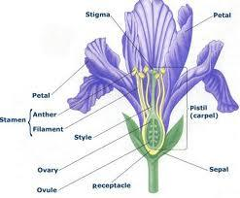
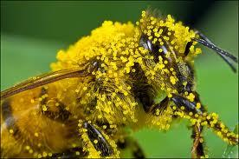
3. reproduce-pass on traits

Slide 17
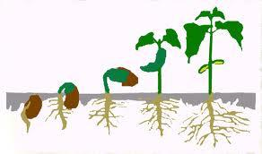
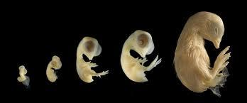
4. grow and develop.

Slide 18
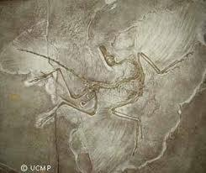
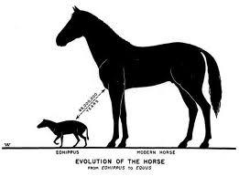
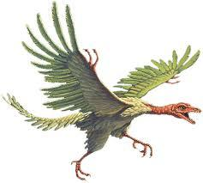
5. Adapt and evolve (change, over time).
Notes:
*

Slide 19
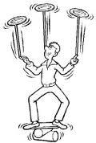
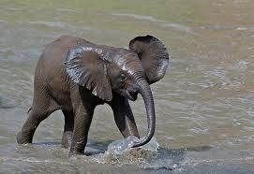
6. maintain a stable internal environment in a process called homeostasis.
Homeostasis is the balance between cells and their environment.

Slide 20
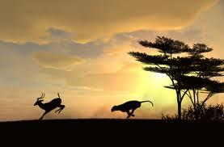
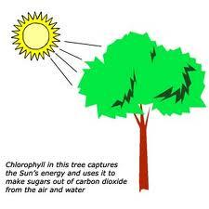
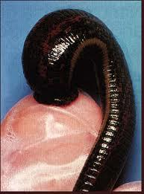
7. obtain and use materials and energy.

Slide 21
Name something WE need to live...

Slide 22
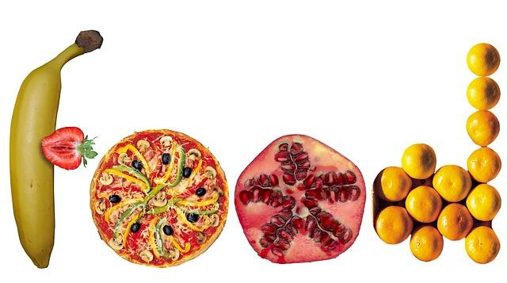
“Bio”molecules….
Bio = life
Proteins, Lipids, Carbohydrates, Nucleic Acids

Slide 23
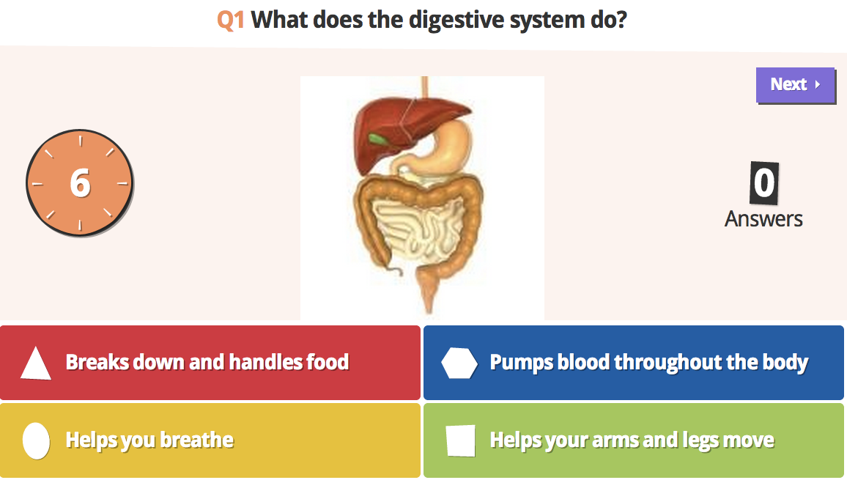
Lets Kahoot!
go to kahoot.it
enter the game pin for the biomolecules pretest
enter your name (first initial and last name)

